Slide 1
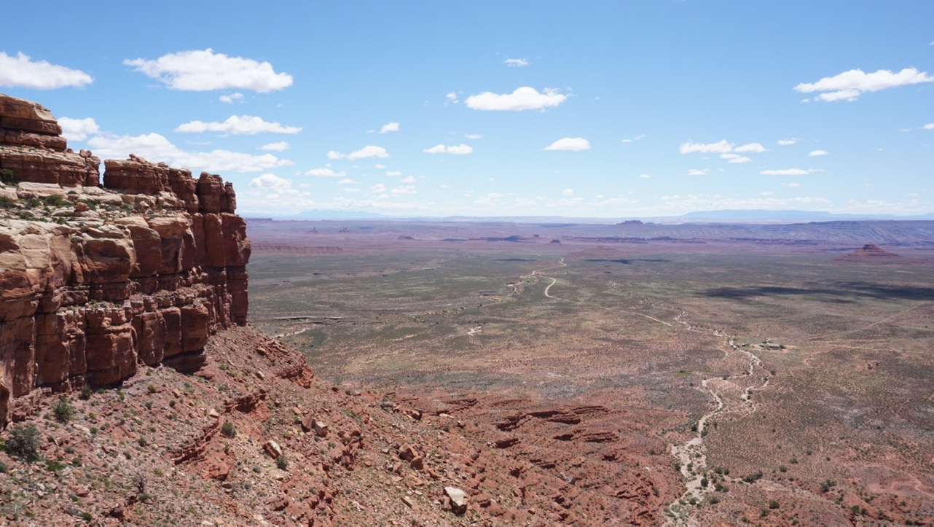
Practical advice on permitting and ethics for geological sampling
12/6/2021
GPS Division — Caltech
Juliet Ryan-Davis & Joann Stock
(Ad Hoc Committee)

Slide 2
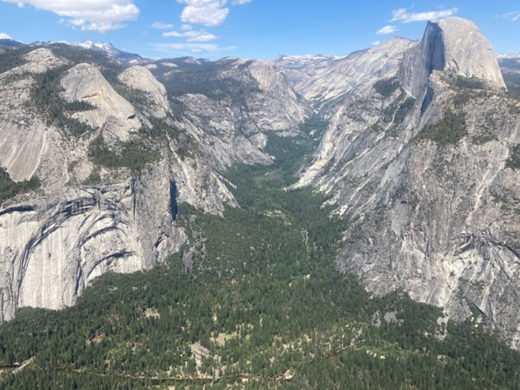
Practical Advice on Permitting and Ethics for Geological Sampling
Ahwaneechee land / Yosemite N.P.
Introduction: motivation for this session
Outline of this session
Q & A : discussion
Future topics (with your suggestions!)
Ahwahnechee land / Yosemite National Park
All photos by Juliet Ryan-Davis & Joann Stock unless otherwise noted. Topo maps from USGS.
Tribes who belong to the land and location of images: to illustrate how much research is necessary to begin to understand the places we access.

Slide 3
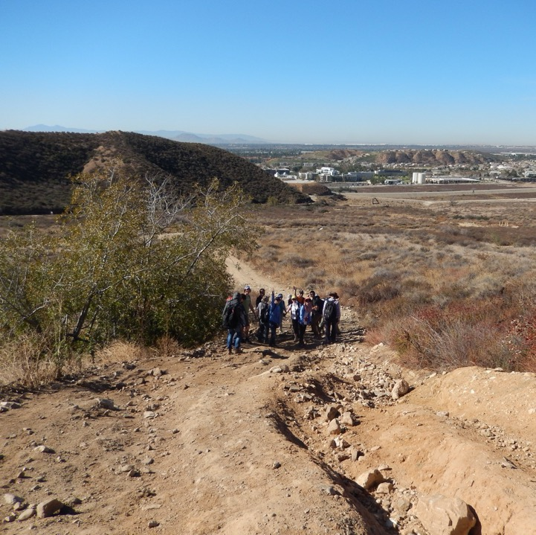
Motivation for this session:
To ensure that Caltech GPS students/post docs/faculty understand federal, state and local permitting requirements and will acquire permits to conduct ethical research
As a starting point for more comprehensive discussions focusing on the practical points of field work permitting, logistics and ethics for GPS disciplines beyond “geology” (e.g., geophysics, planetary science, geobiology, marine science, hydrology)
Tongva/Serrano/Iviatim-Cahuilla land / San Andreas Fault

Slide 4
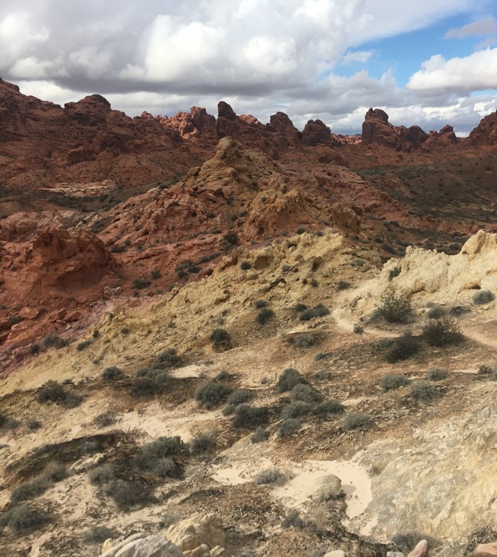
Examples for Geology fieldwork/trips
Class field trip to Joshua Tree National Park
Class field trip to Carrizo Plain National Monument
Class field trip to do geological mapping on BLM land in the Mojave Desert
Class field trip to do geological mapping in Red Rock Canyon State Park
Enrichment camping trip to Mt St Helens
Field research in Sierra Nevada
Research trip to map a recent earthquake fault rupture: Ridgecrest , Hector Mine Fault, El Mayor-Cucapah earthquake
Research field trips in foreign countries – common sense
Moapa Paiute Land
/ Valley of Fire S.P., NV

Slide 5
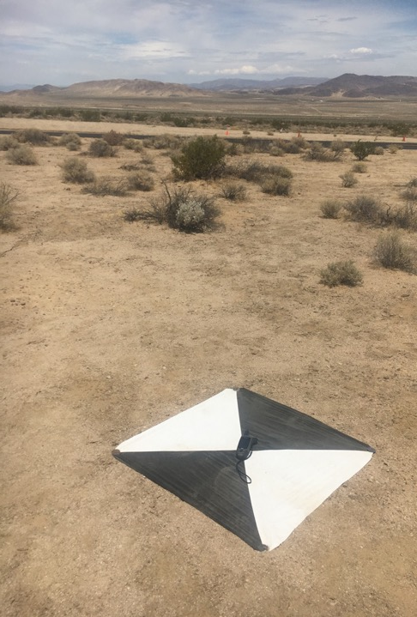
Permission is part of scientific integrity
Obtain permission to access the land you will be working on. Access includes things like group travel on the roads, permits for organized groups, permits for driving on dirt roads
Obtain permission to collect samples from the land you will be working on
This requires knowing about who stewards the land
Sometimes, permission is the default (e.g., public lands are accessible…) must check first (read rules & regulations)!
Kawaiisu Land / Ridgecrest, CA

Slide 6
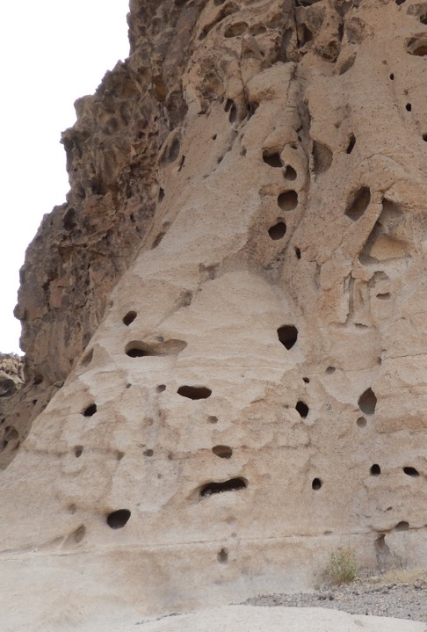
Permission is part of scientific integrity
Knowing about who stewards the land:
  Land management agencies (e.g., USFS, BLM, NPS, State agencies)
  Private entities (e.g., utilities companies, Private landowners)
  Tribal Nations — Sovereign. Some not (i.e., not federally recognized)
  There may be considerable overlap: may require multiple permits
  Reciprocal relationships
Southern Paiute Land / Mojave National Preserve

Slide 7
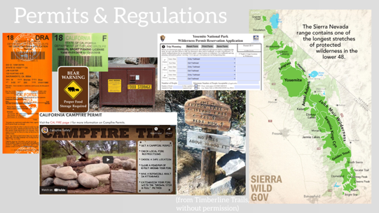
Outline for today’s session:
What are reasons you may need a permit?
Permitting costs $!
Permitting takes time!
Reporting after you use a permit
How to learn about what permit you need
→ Building reciprocal relationships
→ Q & A discussion
Future topics (e.g., offshore permits, geophysical studies, etc.)
Compiled from open source images

Slide 8
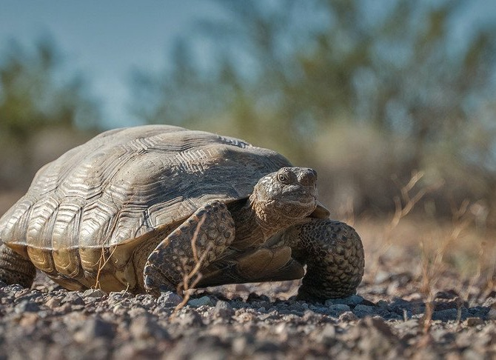
Some reasons you may need a permit:
Ecology (e.g., endangered species)
Resource management (e.g., rockhounding, forest materials)
Land management (preservation from impact)
Archeology based reasons
Tribal Sovereignty
Access/regulation compliance (e.g., roads, wilderness, etc.)
Private land permission
U.S. Fish and Wildlife Service image from https://biologicaldiversity.org/

Slide 9
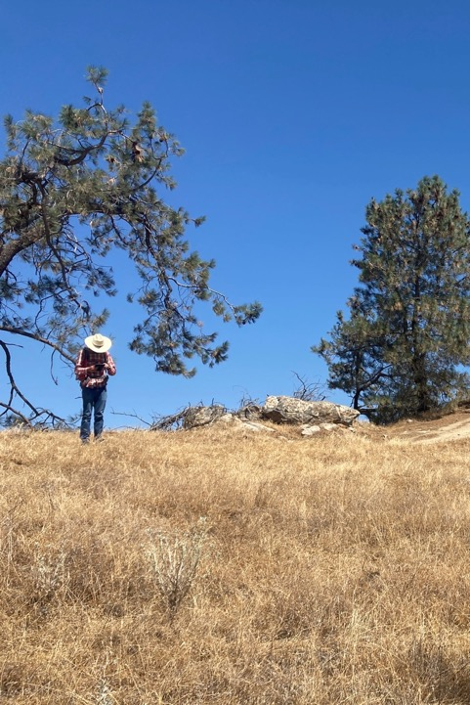
Permitting costs money
The permit may cost you money (pays for time for agency employees to put together the permit)
You may need to pay additional specialists for assessments (e.g., archeologist, ecologist/biologist, etc.)
Dumna/Keyachi Yokuts land
/ Millerton Lake S.R.A., CA

Slide 10
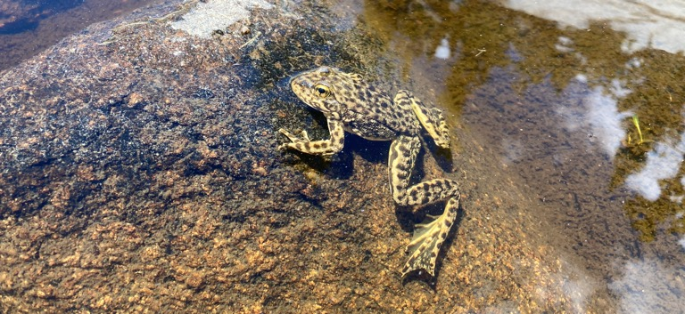
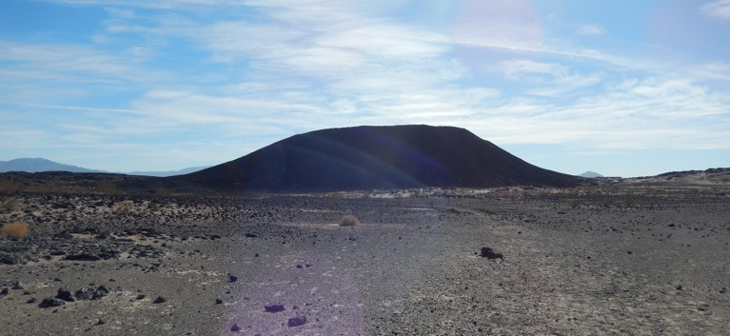
Permitting takes time
Can range in how long (… 2 weeks to 6 months… more!)
→Consider this in proposals (sequence/timeline of activities)
Complex, overlapping land use
→ multiple permit applications: do your research!
Construction, drilling, digging, & soil sampling may be different than other geologic sampling (i.e., rock hounding)
Western Mono land / Kings Canyon N.P.
Serrano / Southern Paiute / Chemehuevi land / Amboy Crater, CA

Slide 11
COURTESY OF
J. RYAN-DAVIS

Slide 12
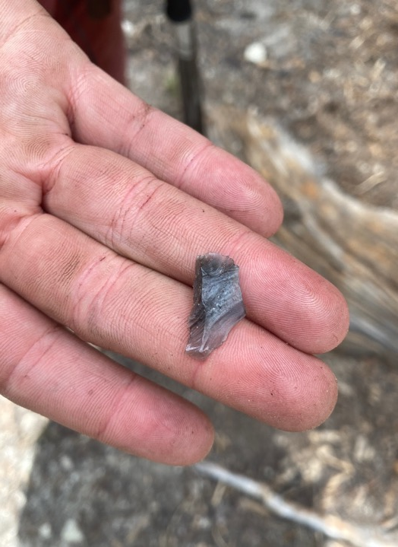
Reporting after permit use
Permits often have time limits (e.g., 1 year, duration of study)
Often required to submit summary/report
Data sensitivity: who stores/“owns” the data and samples? *Data sovereignty*
Extra reporting (e.g., find archeological resources during work)
International geologic sampling (e.g., soils across borders!)
IEDA Sample Registry (e.g., Earthchem, MGDS)
Western Mono land / Kings Canyon N.P.

Slide 13
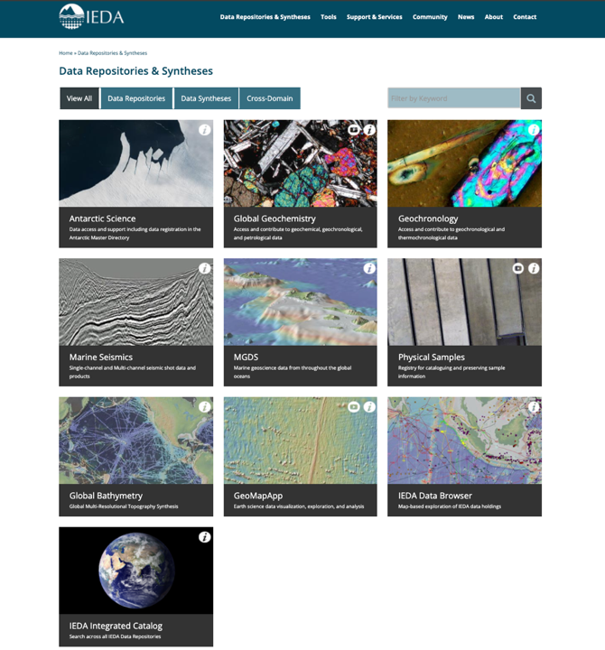
Screenshot: https://www.iedadata.org/data-repositories-syntheses/

Slide 14
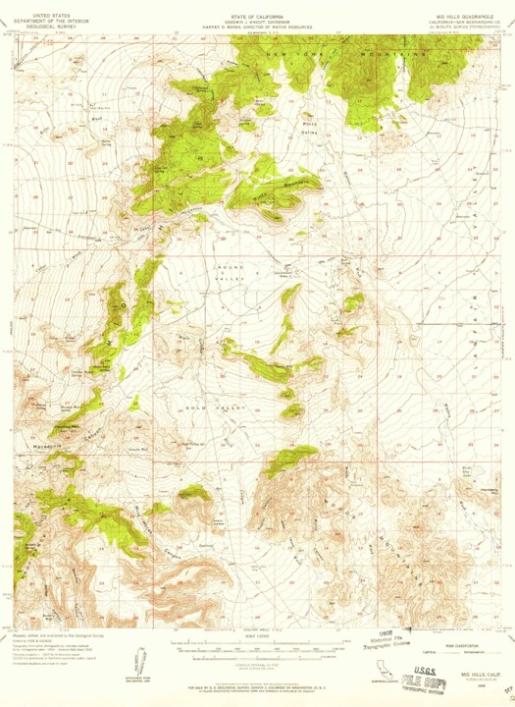
Learning about what permit(s) you need
Wilderness permit, Campfire permit: common permits when camping
Online research:
→ Where is your work located
→ Who is the land manager there?
→ Website, call offices
Topo maps; brochures/pamphlets from agencies
Collaborators in foreign countries

Slide 15
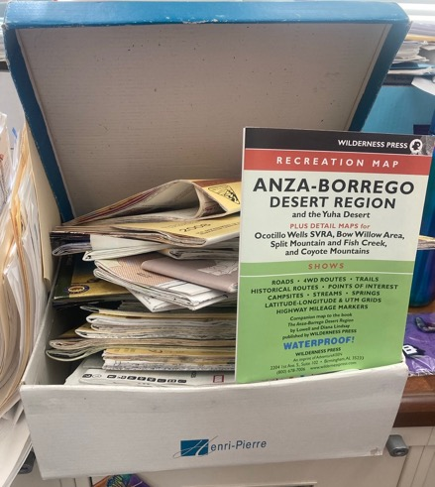
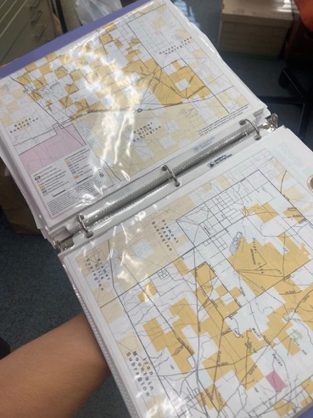
From Prof. Joann Stock’s office! →

Slide 16
Learning about what permit(s) you need
—BLM eGIS: https://blm-egis.maps.arcgis.com/home/index.html
—NGMDB National Geologic Map Database: https://ngmdb.usgs.gov/ngmdb/ngmdb_home.html
→ “Topo View” https://ngmdb.usgs.gov/topoview/viewer/#4/40.01/-99.93
—Owls Head GPS App: https://owlsheadgps.com/owlshead/index.php/mobile-app
—CA Native American Ancestral Land & protected lands interactive map: https://www.arcgis.com/apps/webappviewer/index.html?id=f178c6d7581e4d45ad7ce68c52a1863e&extent=-13566137.4024,3978636.0984,-13090699.0864,4278574.9974,102100

Slide 17
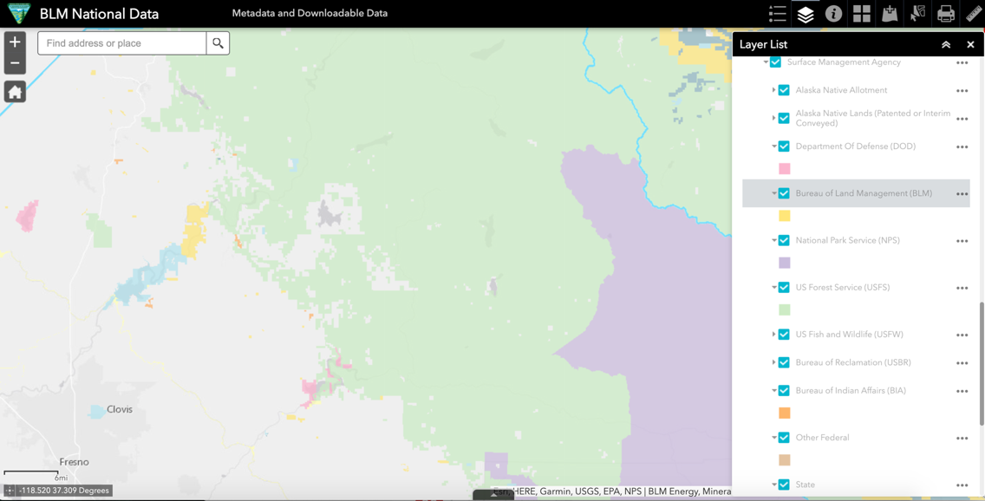
BLM eGIS: https://blm-egis.maps.arcgis.com/home/index.html

Slide 18
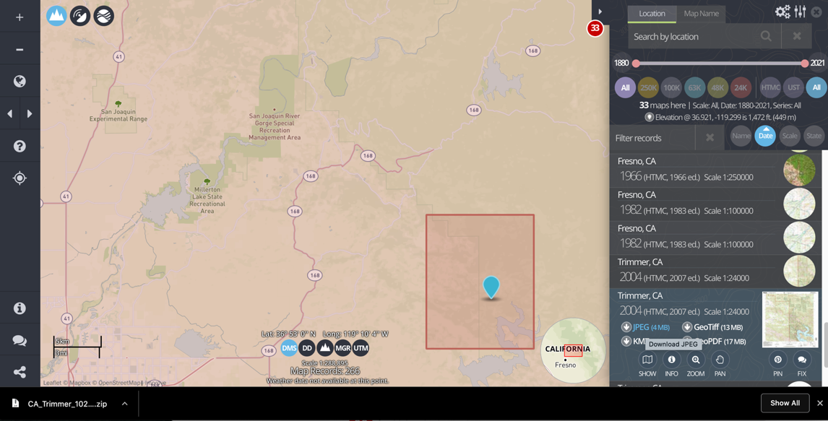
Topo View: https://ngmdb.usgs.gov/topoview/viewer/#4/40.01/-99.93

Slide 19
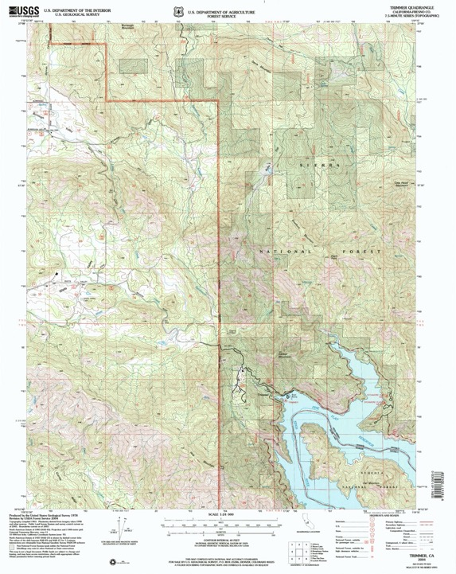
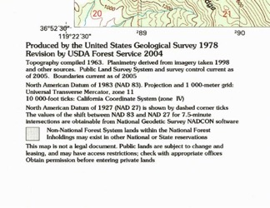
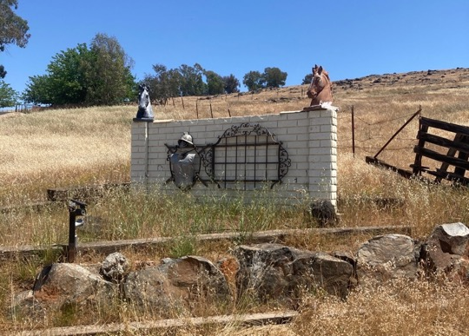
Wechihit / Choynimni / Gashowu Yokuts land
/ private property, CA

Slide 20
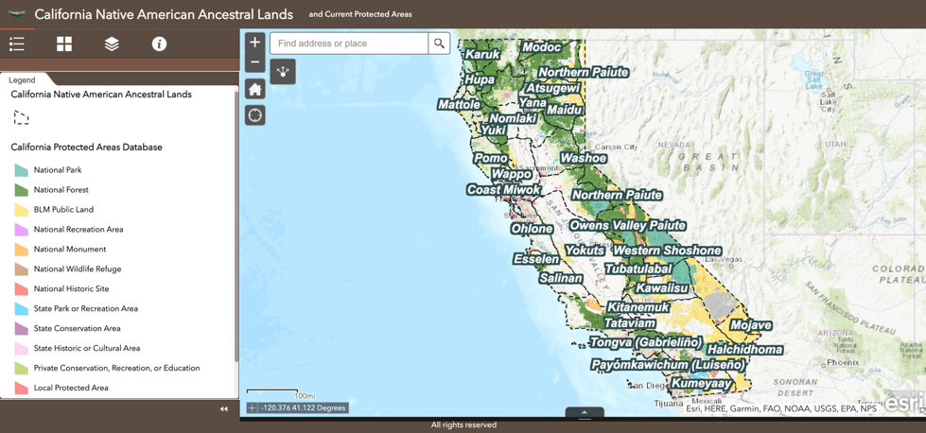
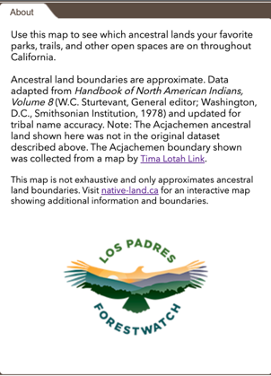
CA Native American Ancestral Land & protected lands interactive map:

Slide 21
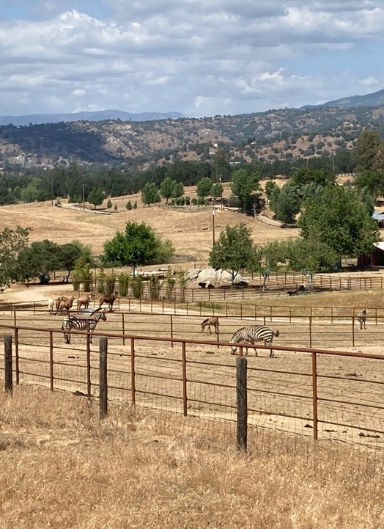
Building Reciprocal Relationships
Permits for land management agencies often require reciprocity: scientists must explain the usefulness of their study/land use to the land manager (e.g., NPS gains scientific knowledge or information about their resource)
Archeology as a discipline is close to geology, and has considered the ethics of conducting research on land stewarded by Indigenous communities in depth.
How can scientists apply this same reciprocity to other land stewards, Indigneous peoples, and communities where research is conducted?
Yokuts land / private property, CA

Slide 22
Building Reciprocal Relationships
References (with a focus on Indigenous communities):
Decolonizing geoscience requires more than equity and inclusion
Liboiron (2021) Nature Geoscience. https://www.nature.com/articles/s41561-021-00861-7
Protocol and Best Practice for the Research on and Public Distribution of Information from Projects involving Indigenous Peoples
Campbell, et al. (2015) Coeur d’Alene Tribe and U. of Idaho / USGS https://www.sciencebase.gov/catalog/item/56ddf1e1e4b015c306fb22fa
Kulana Noi’i
(2018) https://seagrant.soest.hawaii.edu/kulana-noii/
Relationships First and Always: A Guide to Collaborations with Indigenous Communities
Gardner–Vandy & Scalice (2020) Bulletin of the AAS. https://doi.org/10.3847/25c2cfeb.0de1af1a
Equitable Exchange: A Framework for Diversity and Inclusion in the Geosciences
Harris et al. (2021) AGU Advances. https://doi.org/10.1029/2020AV000359

Slide 23
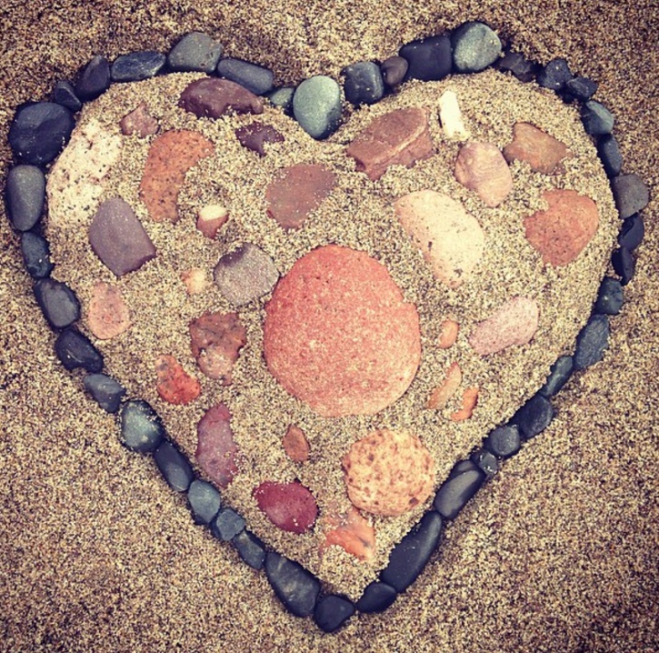
Question & Answer discussion
Guidelines (adapted from CPET Framework for Engagement):
Take space / Make space: we would like to hear voices that have not been heard yet in the discussion! Pay attention to others with raised hands and who have not yet spoken.
Be generous: Express your thoughts, ask questions, make clarifications and share your experiences knowing others will be generous in interpreting the intent.
Avoid making assumptions: tap into prior knowledge/perspectives while recognizing own limitations

Slide 24
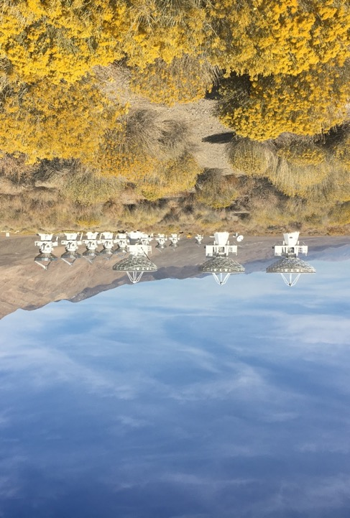
Future topics & suggestions
Development of this and any other ideas into a course: Initial trial Winter Term seminar (reading group?) for exploration of ideas & other topics
Today’s session along with topics of interest/importance
→ to be developed into a seminar course
Sampling/Ethics seminar course general idea:
(~1 hr/week, 10 weeks) for entering Caltech GPS members to formalize learning and understanding of ethics/practices for sampling and fieldwork, broadly across subdisciplines.
Some details and subjects missing from today:
  Geophysics & Seismology–related; Offshore research; Hydrology / Limnology / Eco-Biology research; International research
  What else?
Nüümü-Paiute land
/ Owens Valley Radio Observatory

